Slide 1
Swin Transformer
Computer Vision 24/25
Matteo Fontana

Slide 2
Introduction and Transformer Limitations
Evolution: modelling in computer vision has long been dominated by CNNs.
Meanwhile, in NLP the dominant architecture has become Transformer.
The problem: adapting Transformers from language to vision is difficult due to technical reasons
Vision Transformer (ViT): processes a single low-resolution feature maps.
Global self attention: calculates the relationships between one token and all other tokens.
Consequence: this makes classical Transformers unsuitable for "dense prediction" tasks (such as segmentation) or for high-resolution images
Complexity: quadratic with respect to image size.
Dataset: are required large-scale training dataset to perform well.

Slide 3
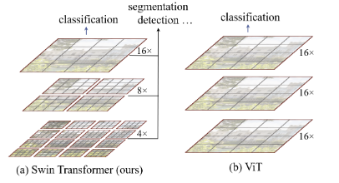
The Solution: Swin Transformer
Key Concept: a hierarchical Transformer using Shifted-Windows mechanism.
Distinguishing features:
It builds hierarchical feature maps (like CNNs), allowing you to model various scales.
It has a computational complexity linear with respect to the image size.
Result: it serves as a "general-purpose" backbone compatible with classification, and dense prediction tasks like object detection and semantic segmentation.

Slide 4
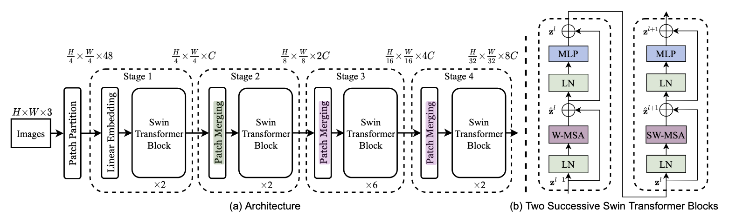
Overall Pipeline Architecture
Patch Partition: the RGB image is split into non-overlapping patches
Linear Embedding: projects the raw feature into an arbitrary dimension C.
Patch Merging: merge 2x2 neighbouring patches as the network gets deeper.
Swin Transformer Blocks: Shifted Window self-attention blocks.
Stages: The architecture is divided into 4 stages to produce a hierarchical representation.

Slide 5
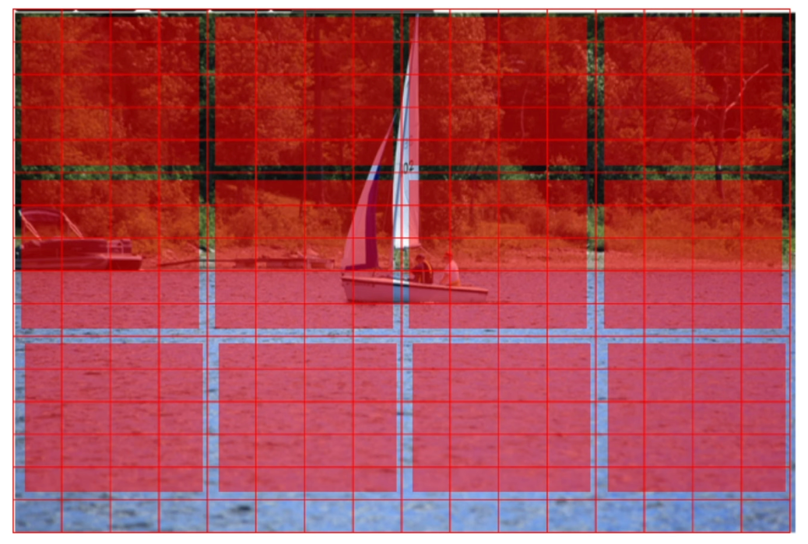
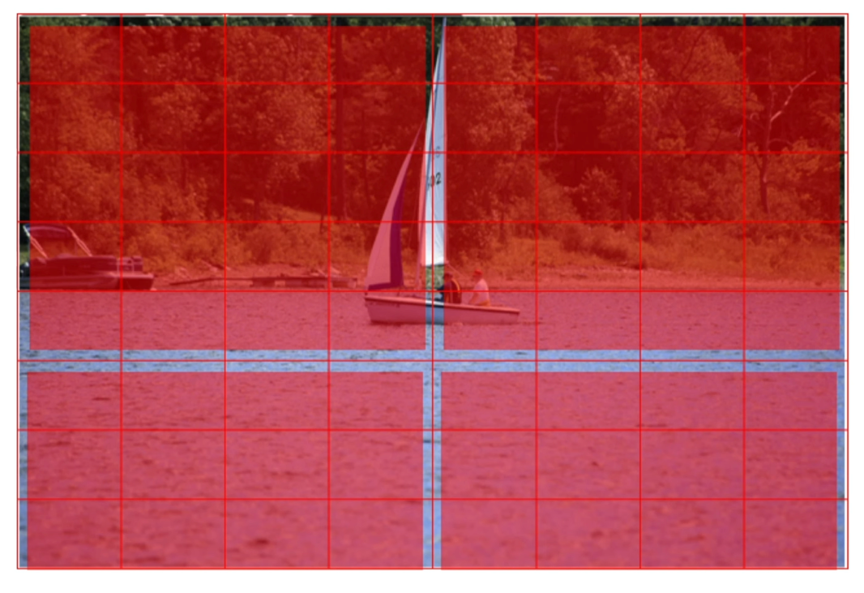
Patch Merging
Objective:
Increase the receptive field.
Produce a hierarchical representation.
Patch merge level:
Concatenate features from groups of 2×2 neighbouring patches.
Reduce the number of patches by a factor of 4 (downsampling 2×).
Result: output with decreasing resolutions (H/4, H/8, H/16, H/32).

Slide 6
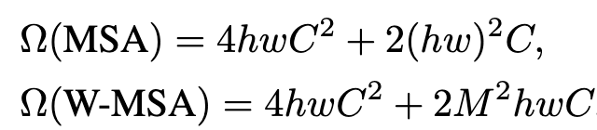
Window-based Self-Attention (W-MSA)
Efficiency: instead of global attention, Swin computes self-attention only within non-overlapping local windows.
Window Size: fixed to M×M patch (default M=7).
Complexity Comparison:
Global self-attention computation is generally unaffordable for a large “h” and ”w”, while the window based self-attention is scalable.
Advantage: scalable for large images.
Linear complexity w.r.t image size.

Slide 7
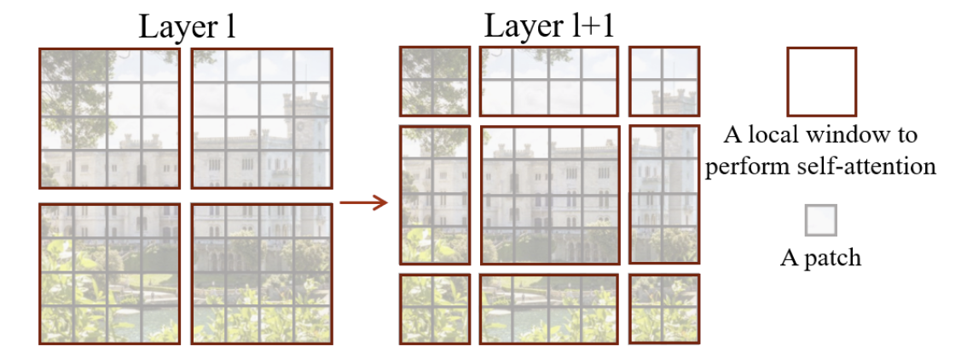
Shifted Window Partitioning (SW-MSA)
The Fixed Window Problem: non-overlapping windows lack connections between them, limiting modelling power.
The Solution (Shifted Windows): alternate partitioning windows between consecutive blocks.
Layer l: Regular partition.
Layer l+1: Translated (shifted) partition of (M/2,M/2) pixels.
Effect: introduces connections between neighbouring windows of the previous layer, maintaining efficiency.

Slide 8
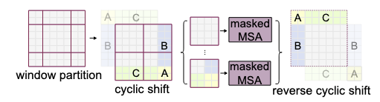
SW-MSA: Efficient Batch Computation
Challenge: moving windows (shifting) creates multiple windows, some of which are smaller than M×M.
Naive Solution: padding (filling) small windows -> Increases the calculation (2×2 becomes 3×3).
Swin Solution (Cyclic Shift): cyclically move the image up to the left.
Windows are composed of non-adjacent sub-parts.
A Masked MSA is used to limit attention within each contiguous sub-window.
Maintains the same number of windows as the regular partition, ensuring low latency.

Slide 9
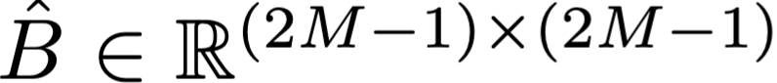
Relative Position Bias
Mechanism: when calculating similarity in attention, a position-related bias term B is added:
Since the relative position along each axis lies in the range [−M + 1, M − 1], we parameterize a smaller-sized bias matrix B̂ and values in B are taken from B̂.
Importance: significantly improves performance compared to no positional coding or the use of absolute positional embeddings (typical of ViT).

Slide 10
Conclusion
Core Mechanics: Linear Complexity, Hierarchical Representation, Relative Position Bias.
Key Innovation: Shifted Window Attention (Efficient Cross-window connections).
Impact: SOTA on Classification & Dense Prediction (Detection/Segmentation).
Vision: A true General-Purpose Backbone uniting Vision and NLP architectures.

Slide 11
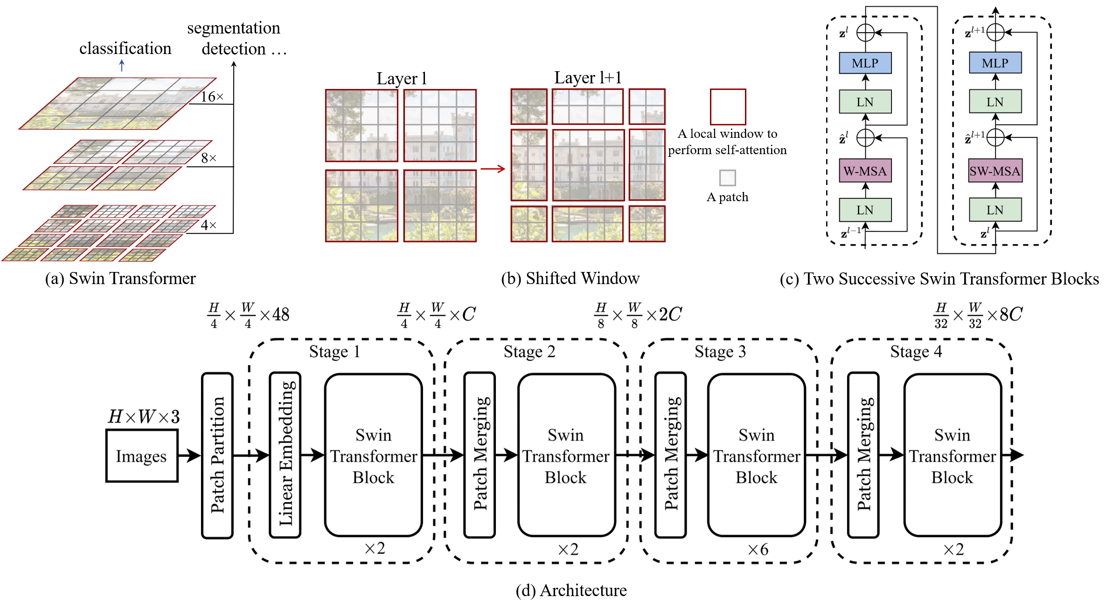
Overall Architecture

Slide 12
Swin Transformer for Chest X-Ray classification

Slide 13
Experiment Design
Objective:
Show the importance of the Window-based attention mechanism in Swin architecture.
Prove the attitude of the model to transfer learning it’s knowledge to a new and totally different domain.
Three different fine-tuning on the same pre-trained (ImageNet-1k) model Swin-T (28M parameters),
Each with a different window size to show the W-based MSA importance:
Window size 7.
Window size 14.
Window size 56 (simulation of global attention).

Slide 14
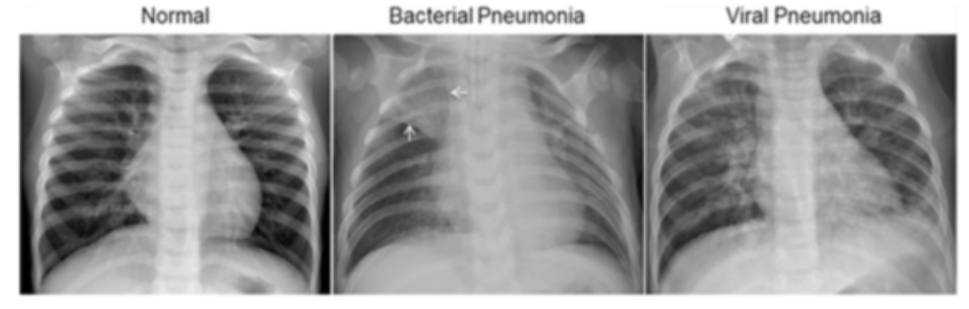
Task: X-Ray Classification
Binary classification of chest X-ray images into Normal and Pneumonia classes.
Pneumonia class is comprehensive of both Bacterial and Viral Penumonia.

Slide 15
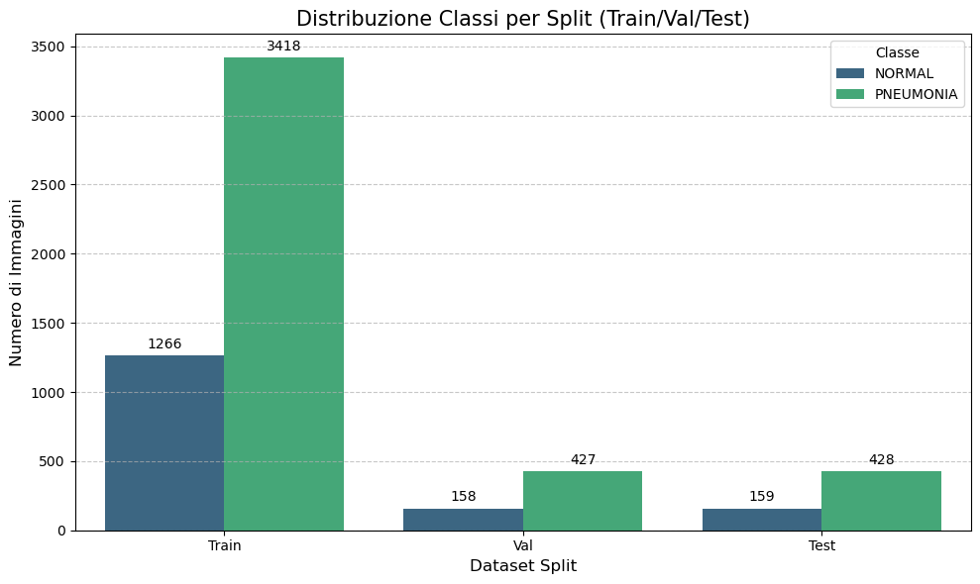
Dataset: Chest X-Ray
Chest X-Ray dataset (5,865 images):
1583 Normal
4102 Pneumonia.

Slide 16
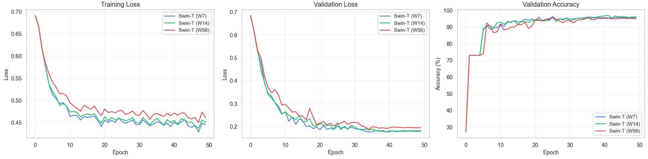
Training Results
Training detail:
Loss Function: Cross Entropy Loss.
Epochs: 50.
Batch size: 32.
Image Size: 224px.
Patch Size: 4.

Slide 17
Classification Metrics
Model | Accuracy | Bal. Accuracy | Sensitivity | Specificity
Swin-T (W7) | 93.53 % | 94.18 % | 92.76 % | 95.60 %
Swin-T (W14) | 94.04 % | 94.13 % | 93.93 % | 94.34 %
Swin-T (W56) | 92.33 % | 92.77 % | 91.82 % | 93.71 %

Slide 18
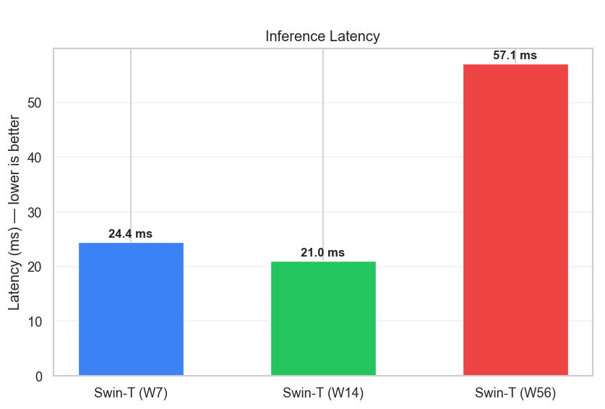
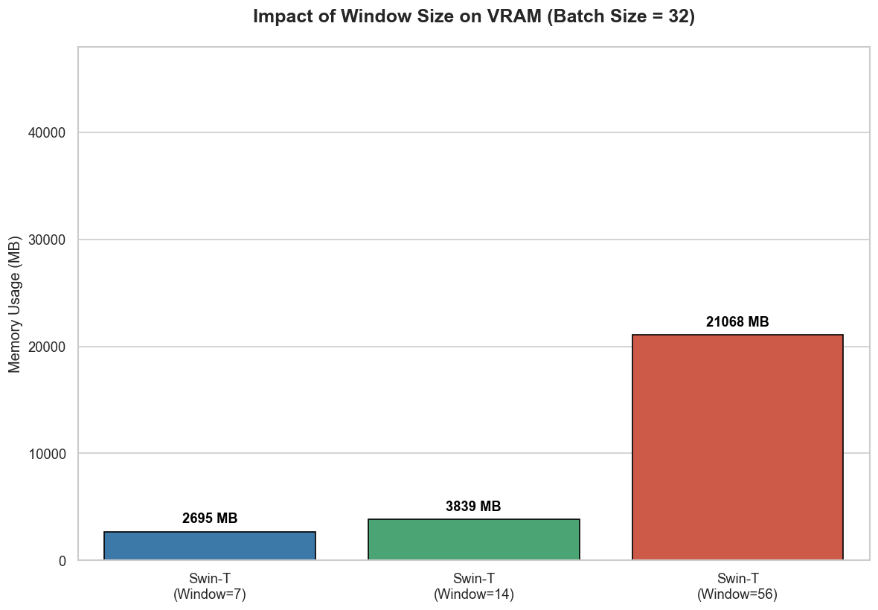
Memory & Speed
VRAM Memory usage results show the increasing trend increasing the window size.
Inference shows an unexpected behavior but confirm the general expected trend.

Slide 19
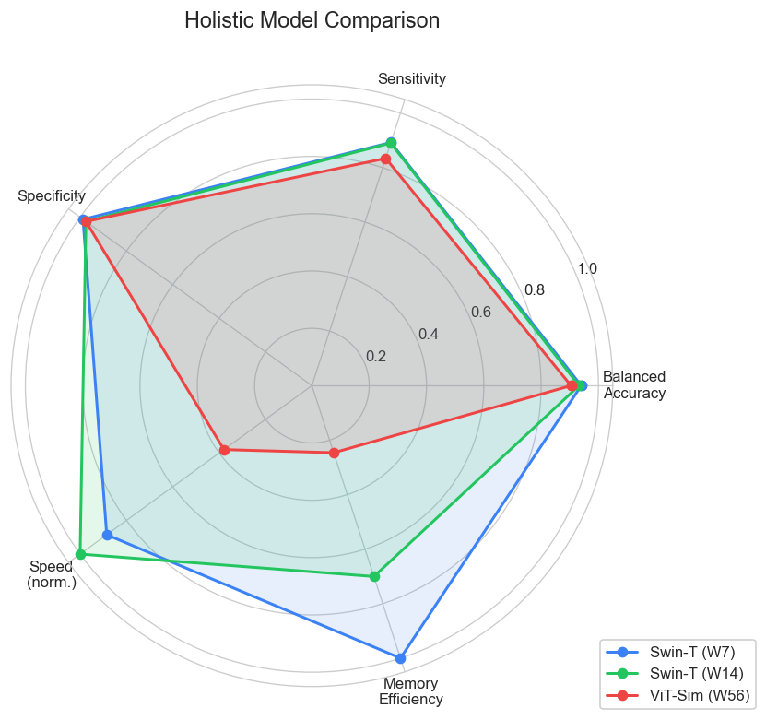
Conclusion
Strong classification performance: all three Swin-T variants achieve 92-94% accuracy on chest X-ray classification, demonstrating effective transfer from ImageNet to medical imaging.
About Window size:
W7 and W14 are essentially tied on overall evaluation and performance metrics.
Increasing the local attention towards global slightly decrease performance.
Global (ViT simulation) attention is the weakest:
Lowest metrics performances overall.
Higher memory cost
Slower Inference.
Locality is a beneficial inductive bias for this task.

Slide 20
Thank you for your attention Questions?

